Slide 1
Requirement 1
Add new ph_solubility button in solubility screening area
Run 3.py file in background and display solubility values in separate page.
Only 4 datapoints
Question :Will PH solubility data be entered into the new SQL table?
Molecule name | pH 1.5 solubility mg/ml | pH 4.5 solubility mg/ml | pH 6.8 solubility mg/ml | pH 9 solubility mg/ml | Temp C
Asprin | 1 | 5 | 6 | 10 | 10
Aspirin | 3 | 6 | 8 | 12 | 25
Aspirin | 6 | 10 | 25 | 50 | 50

Slide 2
Requirement 2
Add solubility correction button next to + button in projects tab
Allow user to feed known solubility values in job submission page→ store data→ use this data to create a linear regression equation
Apply the leaner regression equation on new predictive data points.
Question: New SQL table will be created or fields will be added to the old job_master table ? Need explaination on linear regression equation.
Molecule name | Known solubility value | Predicted solubility value | Temp
Asprin | 1 | 5 | 25
Aspirin | 3 | 6 | 25
Aspirin | 6 | 10 | 25
Need to create corresponding data fields in sql.

Slide 3
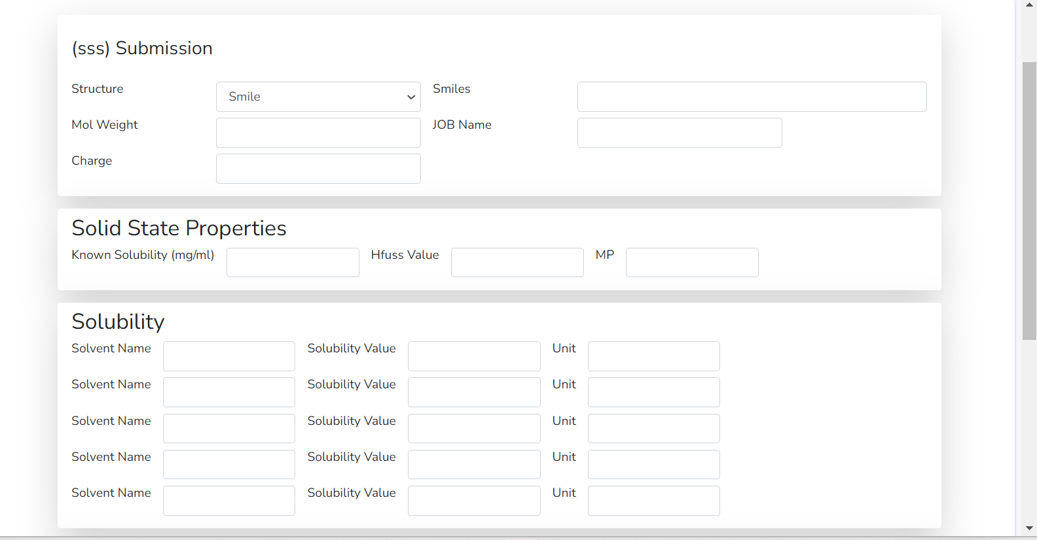
solubility correction button
solubility correction -> Will be taken to job submission page and then user will enter multiple known solubility values?

